Slide 1
Random Variables and Probability Distributions

Slide 2
Random Variables
A random variable is a variable that assumes numerical values associated with the random outcome of an experiment, where one (and only one) numerical value is assigned to each
sample point.
Associates a numerical value with each possible outcome of a chance experiment.
Denoted with capital letters (X, Y , Z) and use lowercase letter for particular value of random variable.

Slide 3
Types of Random Variables
Discrete Variables
Continuous Variables

Slide 4
Discrete Variables
A random variable that can take on at most a countable number of possible values is said to be discrete.
Examples:
The number of books you check out from the library.
The number of heads in a sequence of coin tosses.
The result of rolling a die.
The number of patients in a hospital.
The population of a country.

Slide 5
Continuous Variables
If the range of a random variable X contains an interval either finite or infinite if real numbers, then X is a continuous random variable.
Example:
If Y represents the random variable for the average height of a random group of 25 people, you will find that the resulting outcome is a continuous figure since height may be 5 ft or 5.01 ft or 5.0001 ft. Clearly, there is an infinite number of possible values for height.

Slide 6
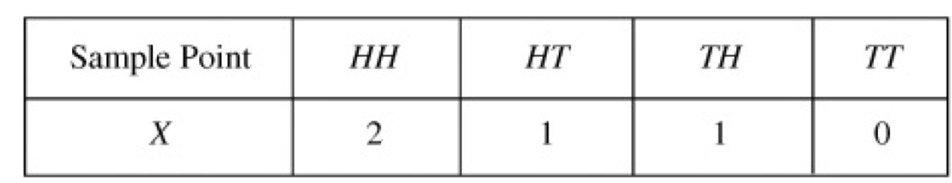
Example
Suppose that a coin is tossed twice so that the sample space is S = {HH, HT, TH, TT}. Let X represent the number of heads that can come up. With each sample point we can associate a number for X as shown in Table. Thus, for example, in the case of HH (i.e., 2 heads), X= 2 while for TH (1 head), X = 1. It follows that X is a random variable.

Slide 7
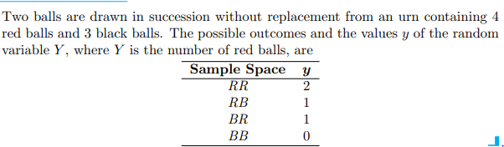
Example

Slide 8
Probability Distribution Function
Probability distribution is a function that is used to give the probability of all the possible values that a random variable can take.
Given a random experiment with its associated random variable (X) and given a real number x. This probability is clearly dependent on the assigned value x.
(X=𝑥_{𝑖} ) ∶ 𝑥_{1 ,} 𝑥_{2 ,} 𝑥_{3 ,} 𝑥_{4 ,} …………. 𝑥_{𝑛}
P(X=𝑥_{𝑖} ) ∶ 𝑃_{1 ,} 𝑃_{2 ,} 𝑃_{3 ,} 𝑃_{4 ,} …………. 𝑃_{𝑛}

Slide 9
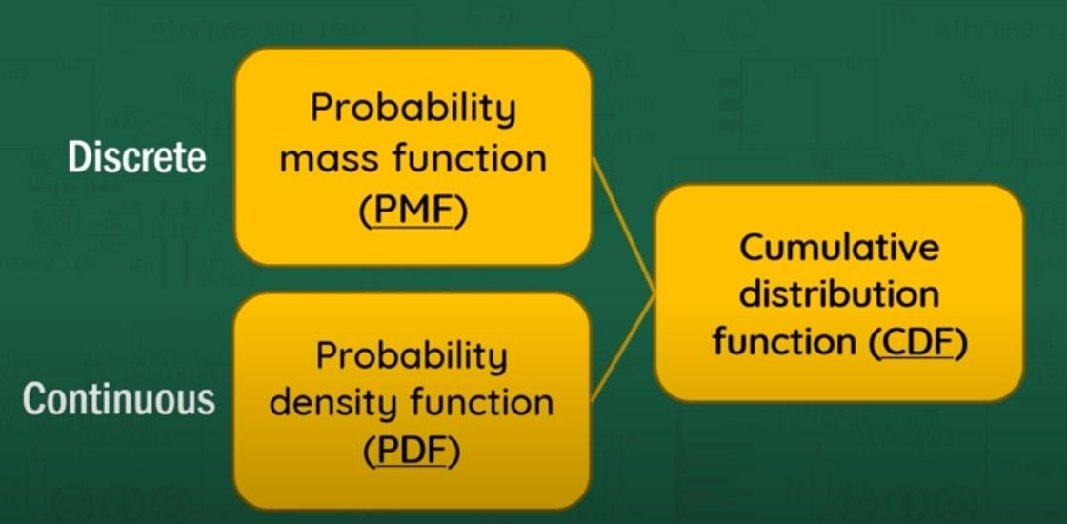
Probability Distribution Functions

Slide 10
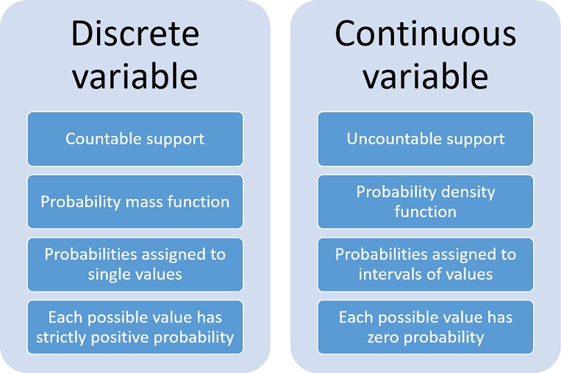

Slide 11
Probability Mass Function
Probability mass function gives the probability that a discrete random variable will be exactly equal to a specific value. The probability mass function is only used for discrete random variables.
The probability mass function is also known as a frequency function. It can be represented numerically as a table, in graphical form, or analytically as a formula.

Slide 12
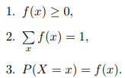
Properties of Probability Mass Function

Slide 13
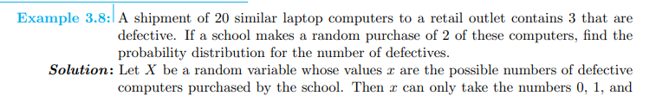
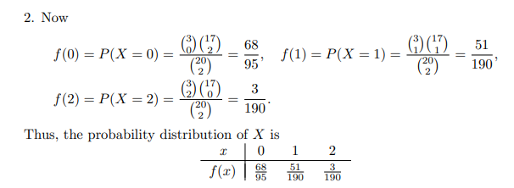

Slide 14
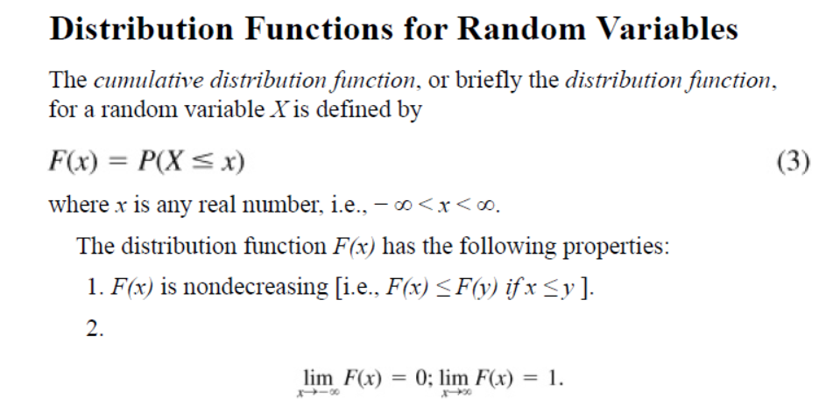

Slide 15
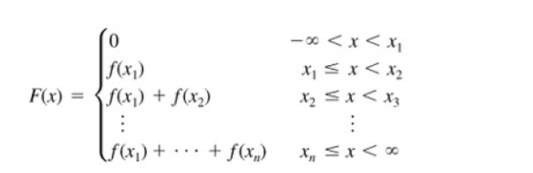
If X takes on only a finite number of values x1, x2, . . . , xn, then the distribution function is given by

Slide 16
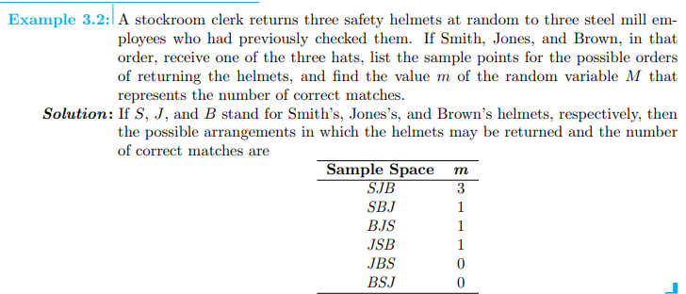
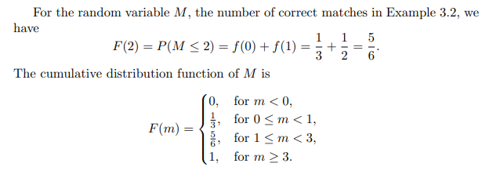

Slide 17
Probability Density Function (PDF)
If the random variable X contain the values with in the range of values. Consider a small interval (a,b) of the length d(x).
Let X be the random variable of a continuous variable and f(x) is the continuous function of x.
f(x)dx represents Probability of ‘X’ lies in infinite interval (a,b)
P(a ≤ X ≤ b)= f(x) dx

Slide 18
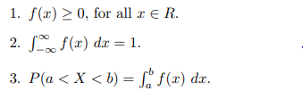
Properties of Probability Density Function

Slide 19
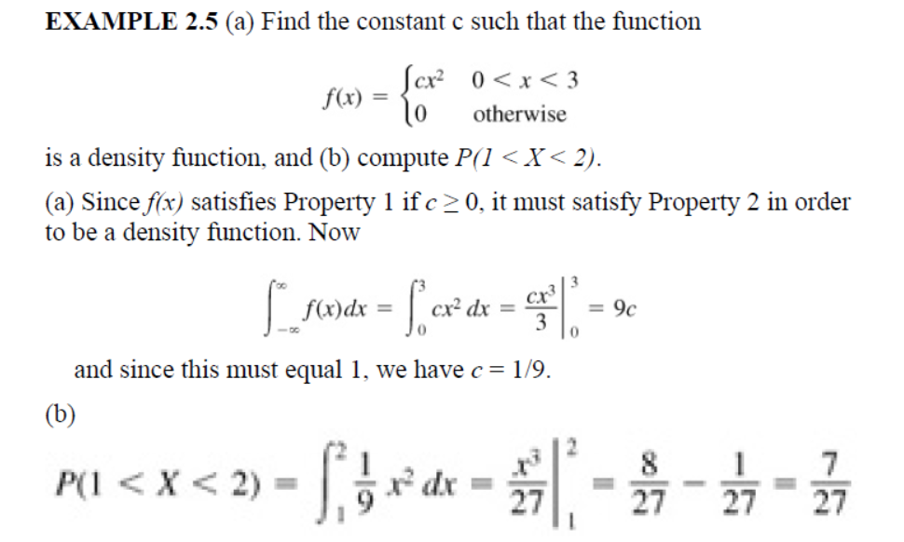

Slide 20
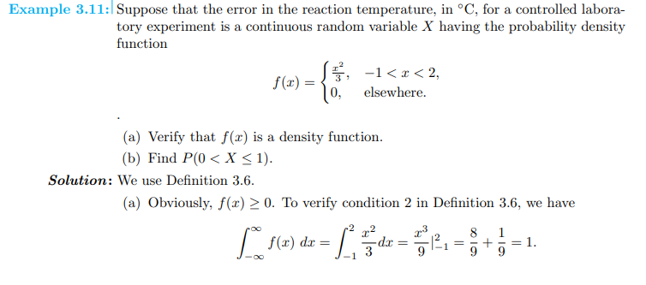
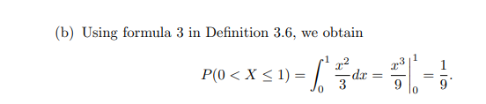

Slide 21
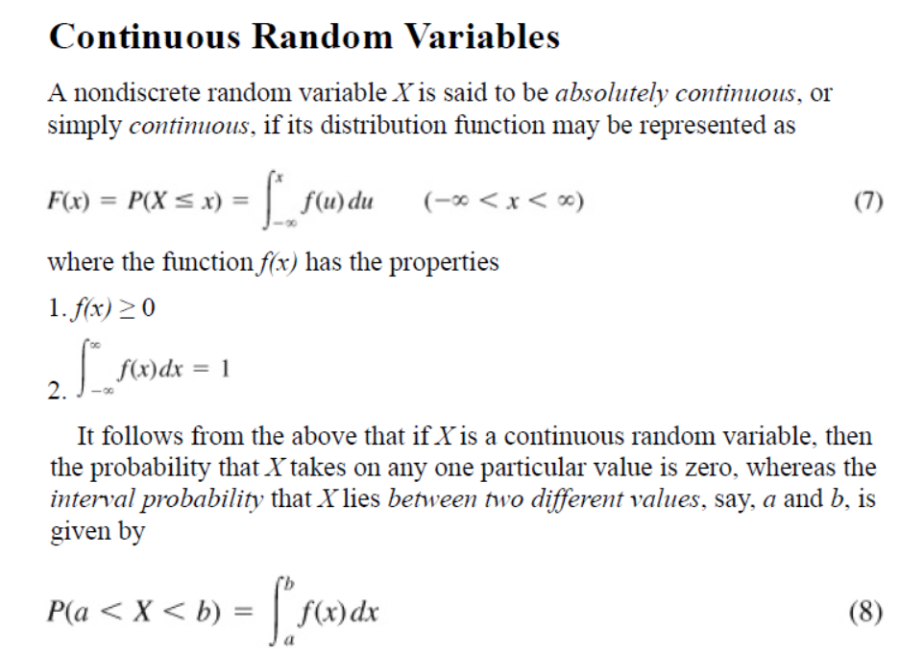


Slide 22
